Slide 1
7.1
Introduction
指導老師：戴天時教授
學 生：施嘉紋

Slide 2
Introduction
Payoff depends only on the final value of the underlying asset :
European calls and puts are sometimes called
vanilla or even plain vanilla options
Path-dependent or exotic:
(on a geometric Brownian motion asset)
1. barrier options
2. lookback options
reflection principle for Brownian motion
3. Asian options
unknown pricing formula, change-of-numeraire argument

Slide 3
7.2
Maximum of Brownian Motion with Drift
指導老師：戴天時教授
學 生：施嘉紋

Slide 4
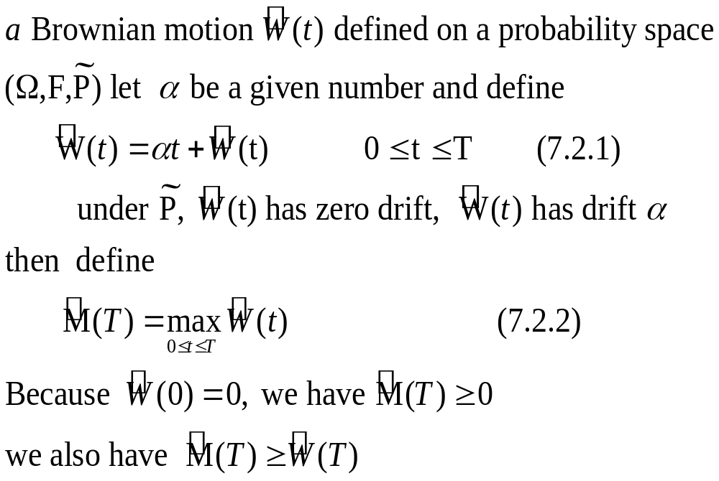
Maximum of Brownian Motion with Drift

Slide 5
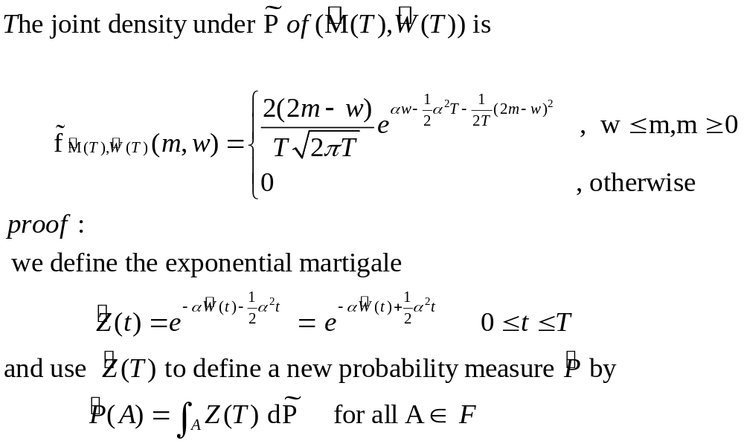
Theorem 7.2.1

Slide 6
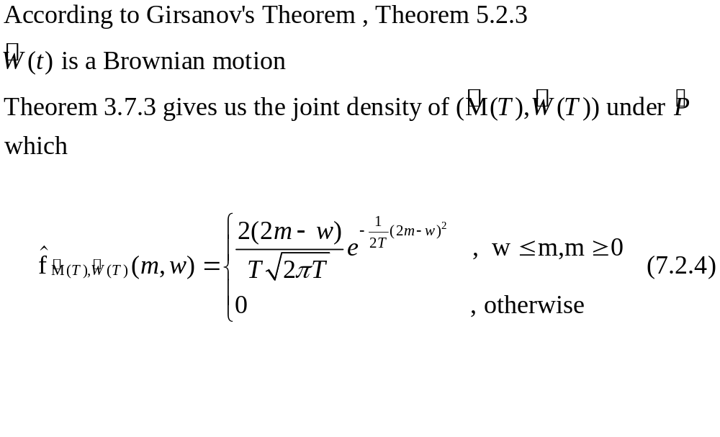
Theorem 7.2.1

Slide 7
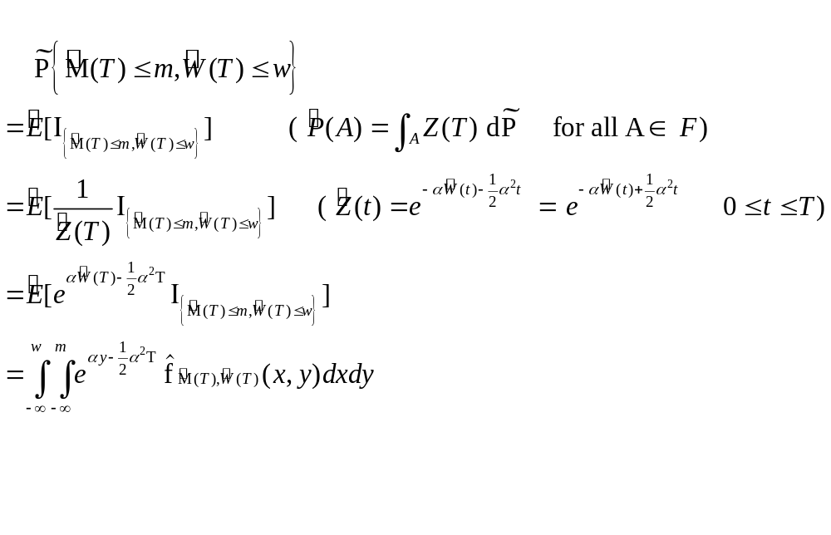
Theorem 7.2.1

Slide 8
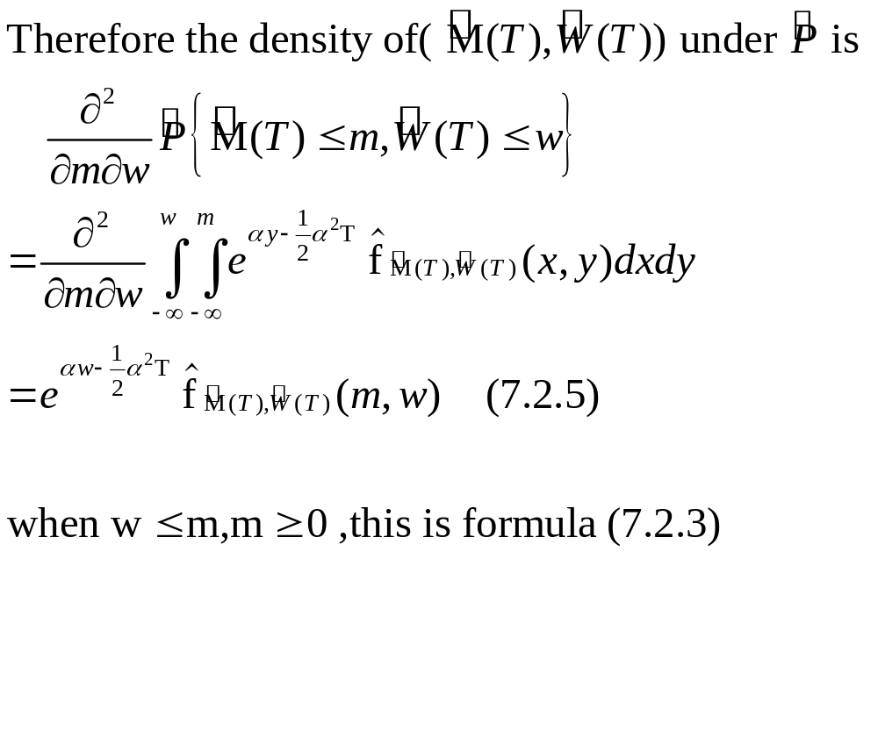
Theorem 7.2.1

Slide 9
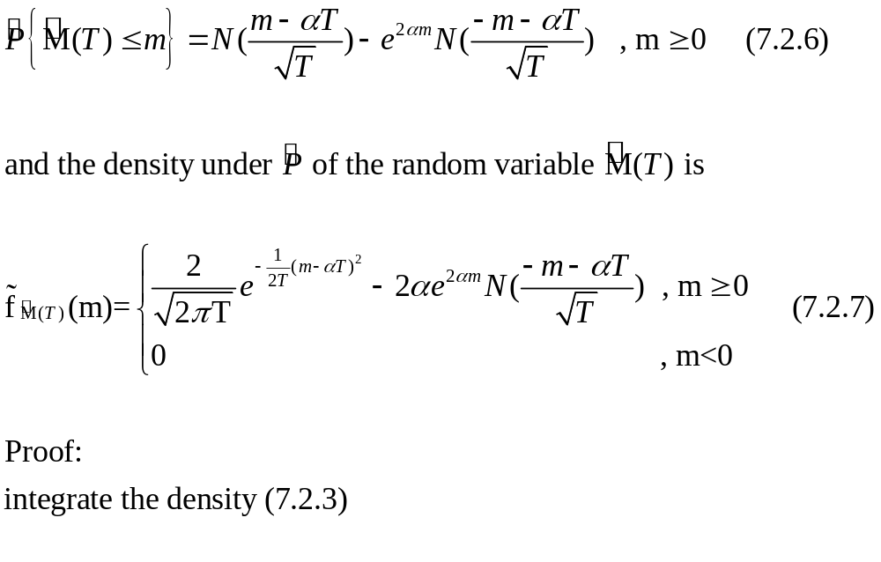
Corollary 7.2.2

Slide 10
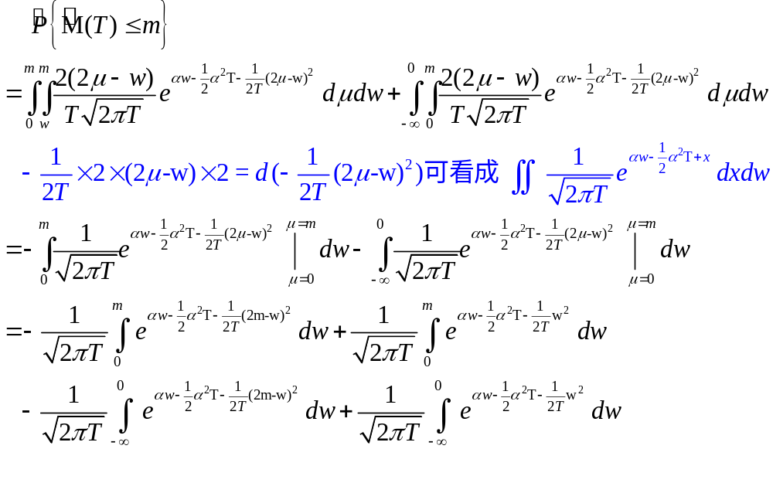
Corollary 7.2.2

Slide 11
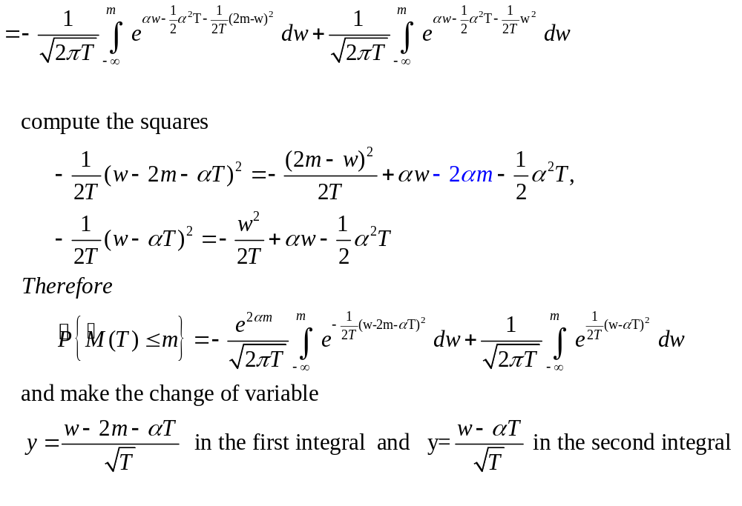
Corollary 7.2.2

Slide 12
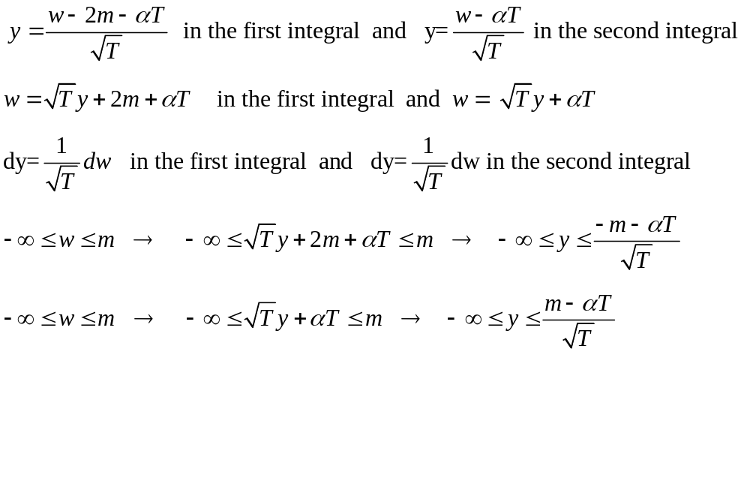
Corollary 7.2.2

Slide 13
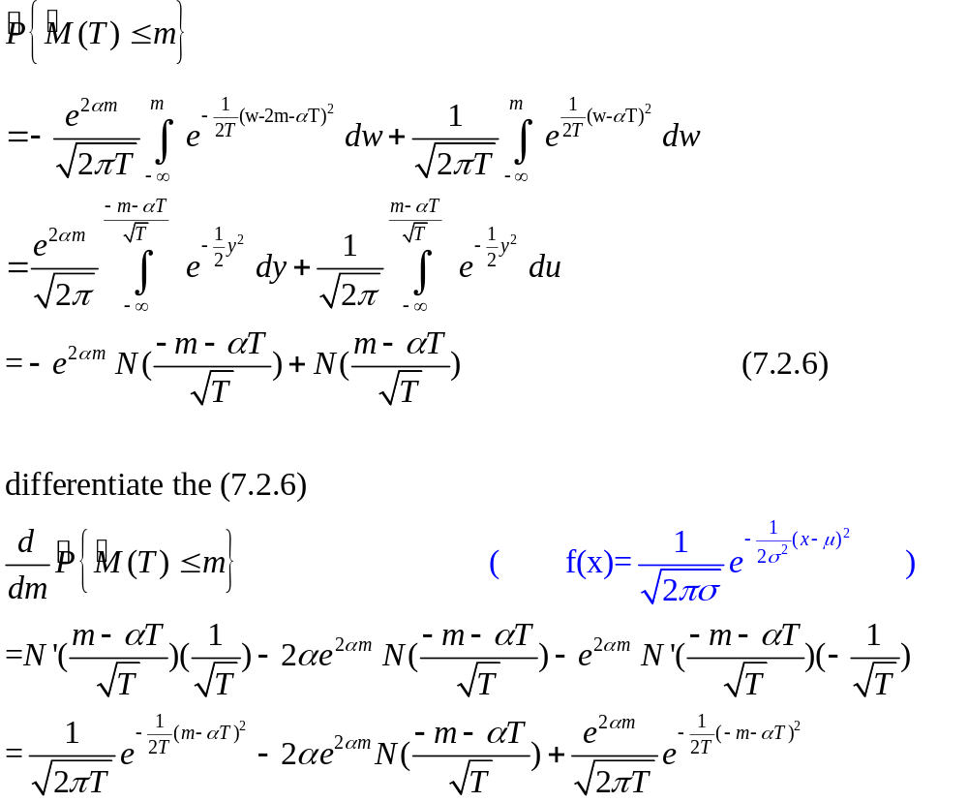

Slide 14
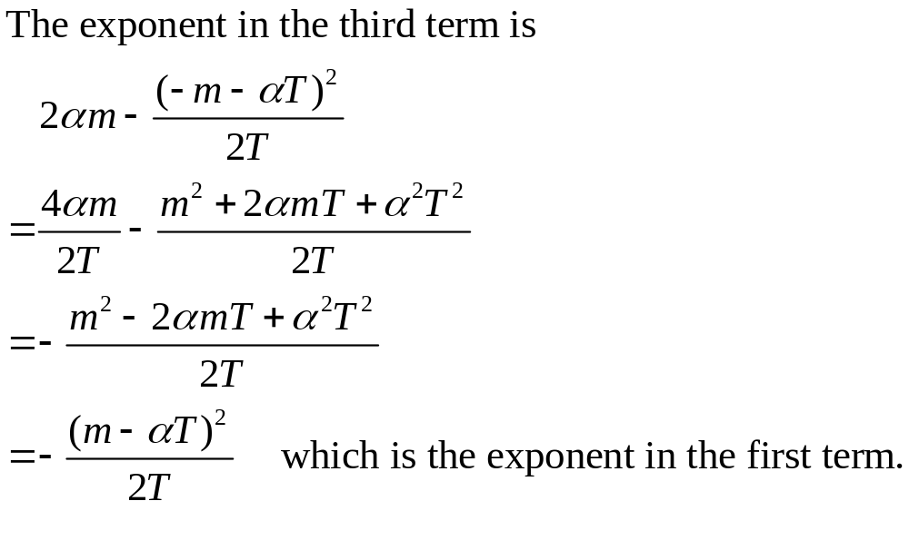
Corollary 7.2.2

Slide 15
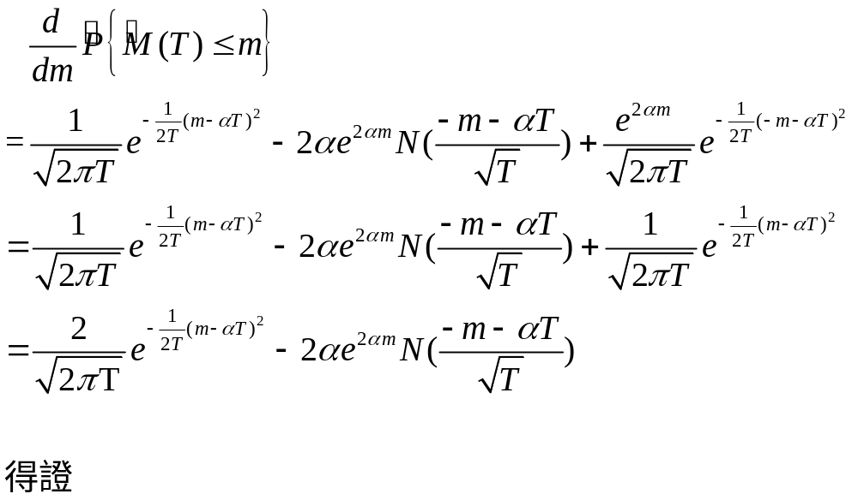
Corollary 7.2.2

